Slide 1
Gaurdians of Space

Slide 2
Details
The basic concepts that we have used in our project are below:
Data Encapsulation
Inheritance
Polymorphism
File Handling

Slide 3
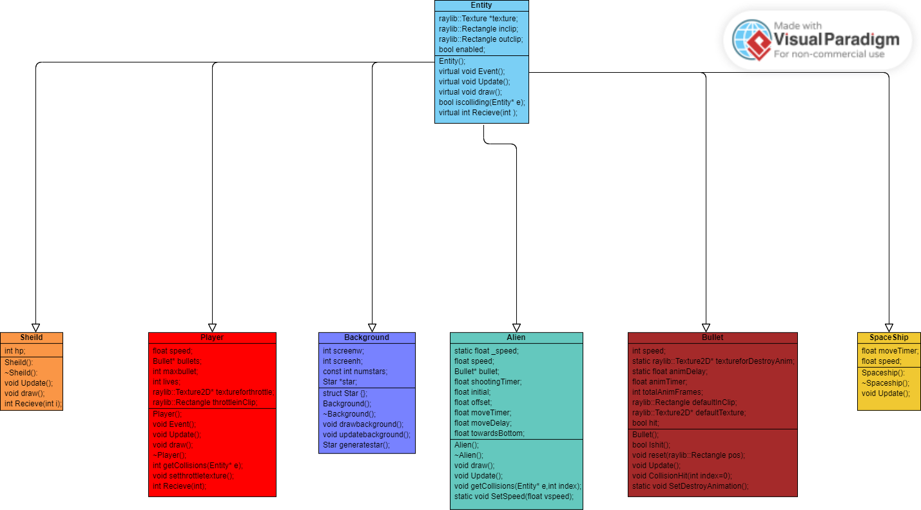

Slide 4


Entity
Base Class
Functions
Collision

Slide 5


Bullet
Update()
Working of Bullets

Slide 6
Collision
Damage Received
Damage Collision

Slide 7


Aliens
Update Function
Movement

Slide 8

Player
Event Function

Slide 9


Receiving damage()
Update()
Shield

Slide 10
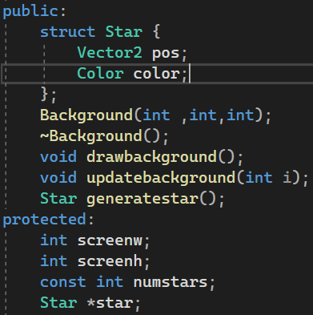
Background
Continuous running Background
Controllable

Slide 11
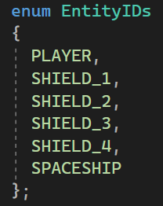


Polymorphism
Virtuality

Slide 12

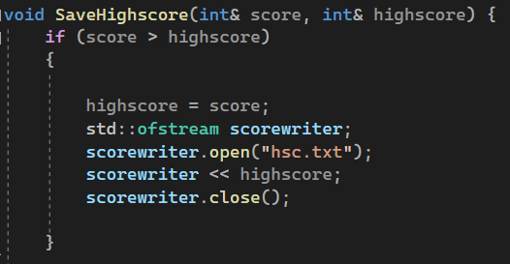
File Handling

Slide 13
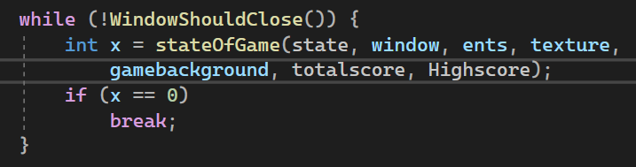
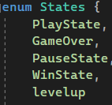

Lives and Game States

Slide 14
Conclusion
What have we learned?
How could this have been improved?
What are our future plans for this?

